Slide 1

XN PROJECT: eda presentation(GROUP)
College of Professional Studies, Northeastern University
Sean McLean
Paula Andrea Romero Melo
Gauri Udaysing Shinde
Ted Smith

Slide 2
INTRODUCTION
Executive Summary
Business Problem
Analytics / Visuals
Recommendations & Findings
Future Research

Slide 3
Executive summary
The group has the task of finding areas of interest for Yeoman Technology Group
In the dataset, each member found patterns that provide insight into possible deliverables for the sponsor
Market Share, Clicks, and Search Query hold primary focus

Slide 4
Business problem
Help pre-Internet brands improve digital sales without disrupting existing wholesale, business, and retail channels.
Utilize extensive Amazon data to enhance client understanding of pricing, advertising, and merchandising programs.
Create scalable Brand Influence and Ad Spend Optimization models to improve advertising strategies and brand positioning on Amazon.

Slide 5
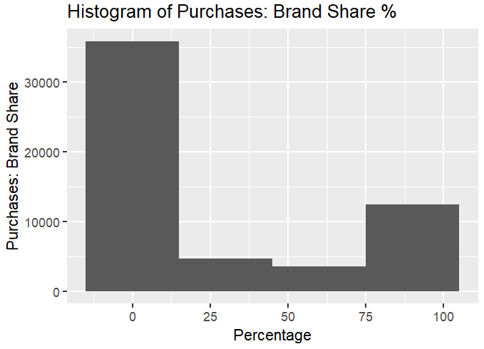
Analytics/visuals
Key Insights from Brand Share Histogram
Market Dominance: A few brands dominate, with most percentages clustered between 75-100%, indicating significant market concentration.
Barriers to Entry: High prevalence of 0% suggests barriers to entry, such as strong brand loyalty and high entry costs.
Competition Intensity: The wide gap between 0% and dominant brands indicates a highly competitive market environment.
Market Maturity: Concentration at extremes suggests a mature market, posing challenges for new entrants but opportunities for differentiation through strategic innovation and marketing.

Slide 6
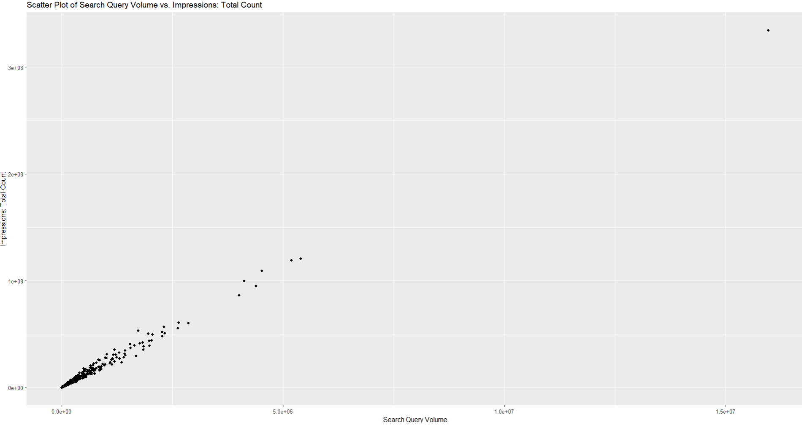

Search query volume Vs. impressions: total count
Lineal relationship
As the volume of search queries increases, the total number of ad impressions also increases.
It suggests that focusing advertising efforts in areas where there is a high volume of search queries may be more effective in reaching a broader audience and increasing ad visibility.

Slide 7
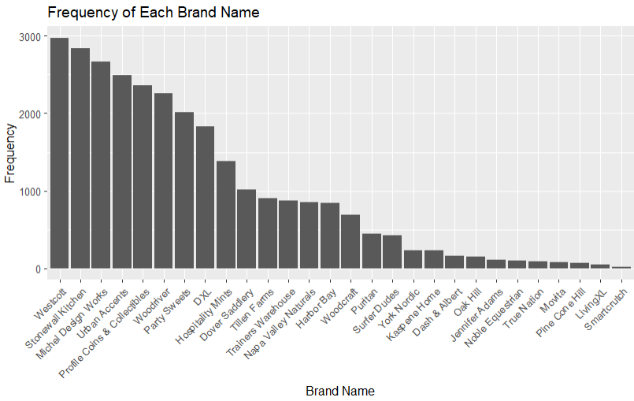
BRANDS FREQUENCY
Brand Popularity.
Strong market presence in the top 5 of brands.
Lower frequencies may be niche players or newer entrants.
There is not evidence of outliers.

Slide 8
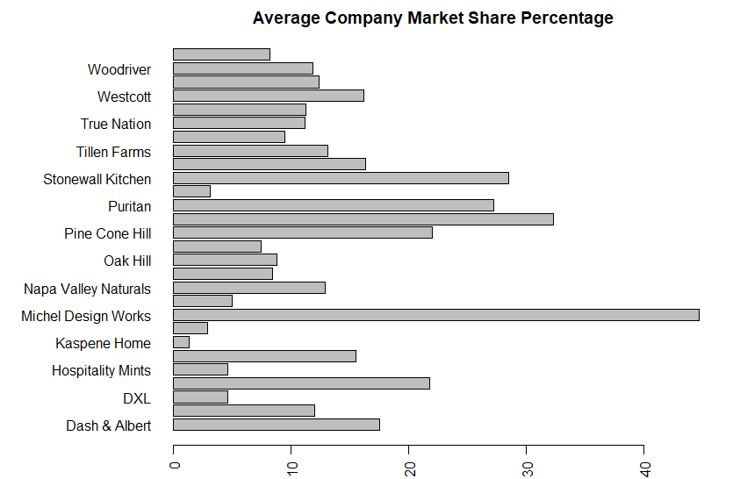
MARKET SHARE BY COMPANY
There is a definite wide range of market share for each of the companies/brands
Smaller market share has potential for greater percentage increase in sales and or profit
Are the smaller brands willing to put up the effort and capital to try changing?

Slide 9
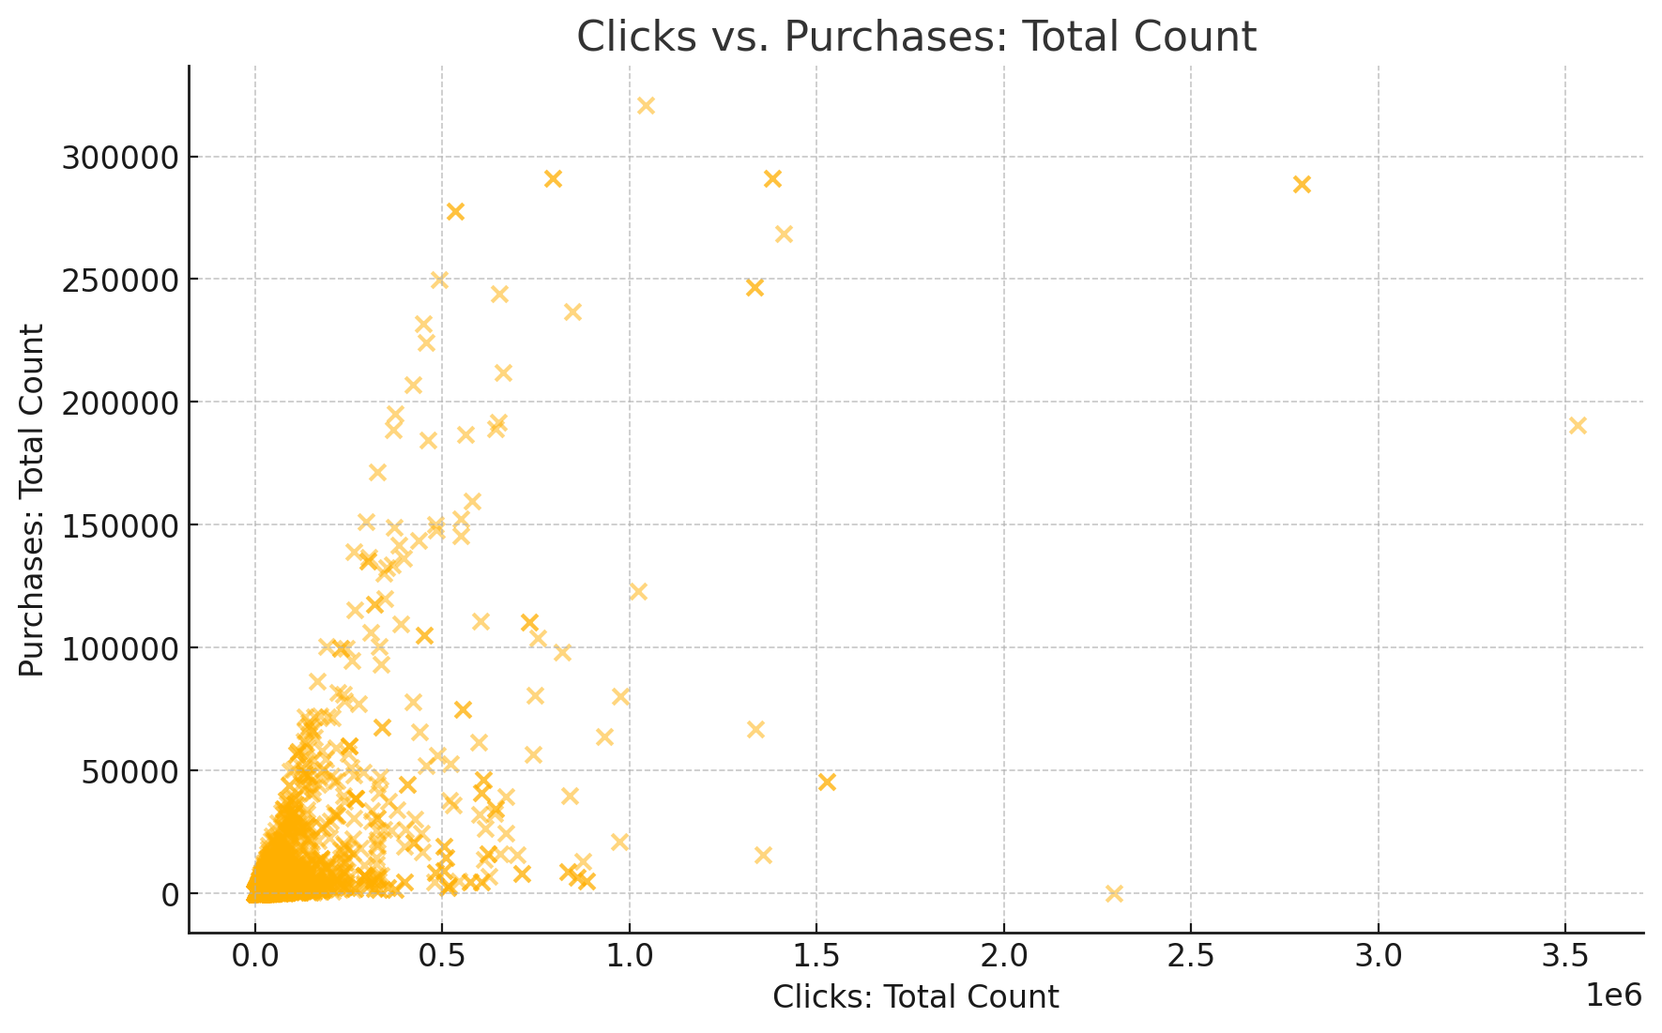

Clicks vs. Purchases: Total Count
Data Concentration: Most queries have low clicks and purchases, indicating low engagement and conversion.
Outliers: Some queries have high clicks but low purchases, highlighting inefficiencies in conversion.
Recommendation: Focus on optimizing high-click, low-purchase queries to improve overall performance.

Slide 10
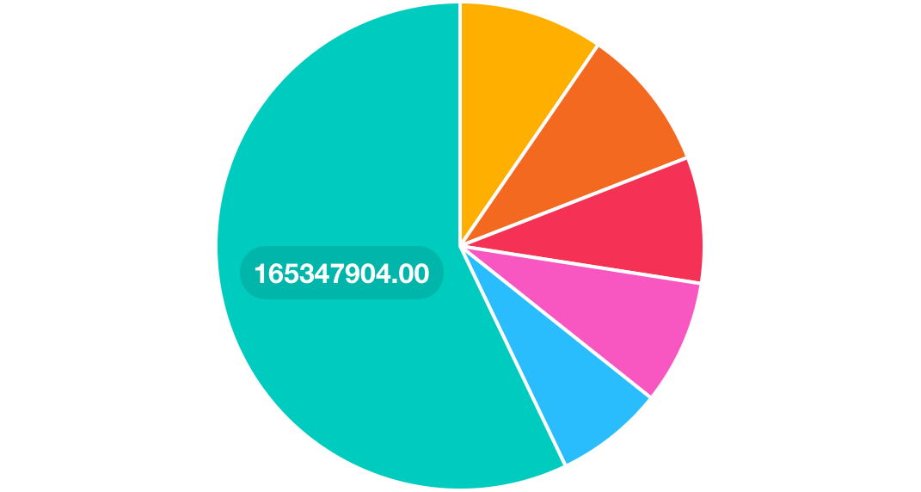
Simplified Distribution of Clicks by Brand
Dash & Albert: The largest share of total clicks, indicating high user interest and engagement.
Kaspene Home: Substantial portion of clicks, reflecting strong brand visibility.
Urban Accents: Significant share, suggesting effective query performance.
PineCone Hill: Moderate clicks, indicating steady user interest.
Stonewall Kitchen: Noticeable portion of clicks, showing competitive engagement.
Others: Aggregated smaller brands, highlighting the dominance of top brands.

Slide 11
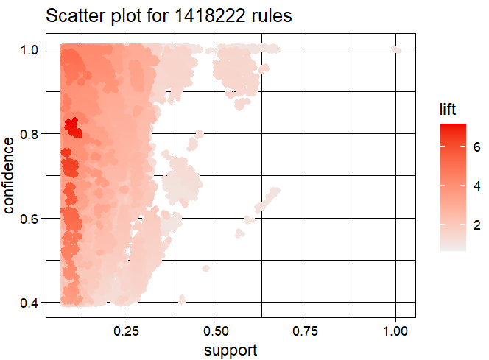
Association mining of dataset
Understanding Key Metrics:
Support: Frequency of itemsets in the dataset (x-axis).
Confidence: Reliability of the rule; how often items appear together (y-axis).
Lift: Strength of association; higher values indicate stronger associations (color intensity).
Interpreting the Scatter Plot:
High Support & Confidence: Reliable but less frequent itemsets, valuable for strong associations.
High Lift: Strong associations suggesting potential cross-selling opportunities, highlighted by deeper red points.
Dense Low Support Cluster: Many itemsets with low frequency but potentially high confidence and lift, indicating interesting associations.
Implications for Amazon:
Popular Itemsets: Identifying common combinations for inventory and promotions.
Reliable Associations: High confidence rules useful for targeted marketing.
Hidden Relationships: High lift insights to enhance recommendation systems, boosting sales through strategic product placements.

Slide 12
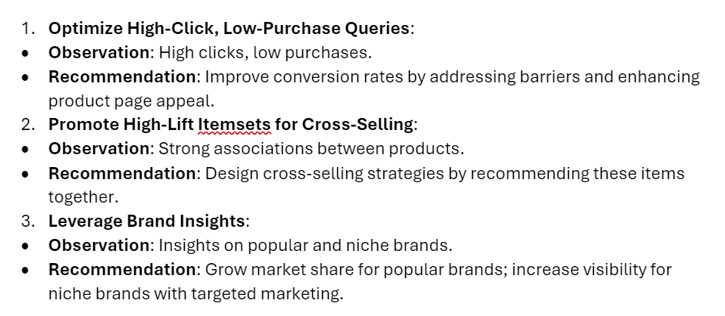
Recommendations and findings

Slide 13

Future research
Recommend continued refinement of analysis to provide YTG with specific guidance
Exploring temporal trends involves investigating variations in purchasing patterns over time, understanding seasonal trends, promotional impacts, and long-term shifts in consumer behavior.
Advanced predictive modeling integrates advanced machine learning techniques to forecast future sales trends and customer preferences, enabling more accurate business decisions and optimal resource allocation.

